Slide 1
Arduino Interrupts

Slide 2
Interrupts
A request for the processor to ‘interrupt’ the currently executing process, so the event can be processed in a timely manner
Also referred to as ‘trap’
If the request is accepted: the processor suspends current processes, saves its state, and executes Interrupt Service Routine (ISR) or, Interrupt Handler
Concept of ‘Interrupt’ is very useful when implementing any of the switch debouncing methods.

Slide 3
Introduction
Microcontroller normally executes instructions in an orderly fetch-execute sequence as dictated by a user-written program.
However, a microcontroller must also be ready to handle unscheduled events that might occur inside or outside the microcontroller.
The interrupt system onboard a microcontroller allows it to respond to these internally and externally generated events. By definition, we do not know when these events will occur.
When an interrupt event occurs, the microcontroller will normally complete the instruction it is currently executing and then transition program control to an Interrupt Service Routine (ISR). This ISR handles the interrupt.
Once the ISR is complete, the microcontroller will resume processing where it left off before the interrupt event occurred.
Scheduled events are not interrupted

Slide 4
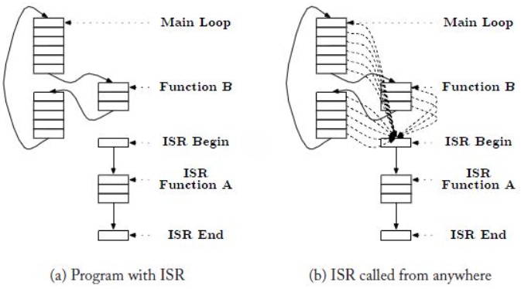
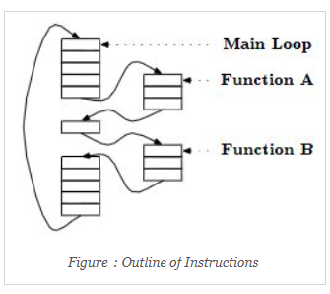
Introduction
Figure: Outline of Instructions
Figure: Outline of Instructions with ISR

Slide 5
Why do we need it?
Let’s think about a real-life example:
You are heating up your food using the microwave.
In this case, you can either:
    Stare at the microwave while it heats up the food
    Go about your life normally and go to the microwave when you get the signal that the food has been heated up
Which of the above-mentioned options do you think is more efficient?
Usually, we want to go about our life while the food is being heated up.
This is because we want to make efficient use of our time.
It is very similar for processors as well.
We hear the ting sound from the microwave, stop what we are doing, and go to take out the heated food.
This ‘ting’ sound is an interrupt.
Similarly, if the processor is waiting for some conditions to be fulfilled to perform a specific task (task 1):
    It can wait and halt other processes till the conditions for that task is fulfilled.
    It can execute the normal instructions and halt them for a brief time once the conditions for task 1 have been fulfilled, finish task 1 and go back to executing the main routine.
Clearly, the 2nd option is better for maximizing the processor’s resource utilization.
This is where interrupts come in handy.
When the conditions for task 1 has been met, it can simply trigger an interrupt, stop the main routine to complete the task and once finished go back to the main routine.

Slide 6
The Main Reasons You Might Use Interrupts
To detect pin changes (eg. rotary encoders, button presses)
Watchdog timer (eg. if nothing happens after 8 seconds, interrupt me)
Timer interrupts - used for comparing/overflowing timers
SPI data transfers
I2C data transfers
USART data transfers
ADC conversions (analog to digital)
EEPROM ready for use
Flash memory ready

Slide 7
Interrupt Vector
The interrupt vectors and vector table are crucial to the understanding of hardware and software interrupts. Interrupt vectors are addresses that inform the interrupt handler as to where to find the ISR (Interrupt Service Routine, also called Interrupt Service Procedure).
Misspelling the vector name (even wrong capitalization) will result in the ISR not being called and it will not also result in a compile error.

Slide 8
Interrupt Function of Arduino
Re-enables interrupts (after they’ve been disabled by noInterrupts()). Interrupts allow certain important tasks to happen in the background and are enabled by default. Some functions will not work while interrupts are disabled, and incoming communication may be ignored. Interrupts can slightly disrupt the timing of code, however, and may be disabled for particularly critical sections of code.
    Syntax: interrupts() and noInterrupts(), all are opposite of interrupts()
    Parameters: None
    Returns: Nothing
Example Code: The code enables Interrupts.
      void setup() {}
      void loop() {
      noInterrupts();
      // critical, time-sensitive code here
      interrupts();
      // other code here
      }

Slide 9
Global Enable
The main interrupt flag
This is used to turn all the interrupts on or off
Example: sei(); //globally enable interrupt
Available in the Status Register (SREG): Bit 7

Slide 10
Atmega328p Interrupt Vector Table
The ATmega328P provides support for 25 different interrupt sources. These interrupts and the separate Reset Vector each have a separate program vector located at the lowest addresses in the Flash program memory space.
The complete list of “Reset and Interrupt Vectors” in ATMega328P is shown in this table. Each Interrupt Vector occupies two instruction words.
The list also determines the priority levels of the different interrupts. The lower the address the higher is the priority level. RESET has the highest priority, and next is INT0 – the External Interrupt Request 0.

Slide 11
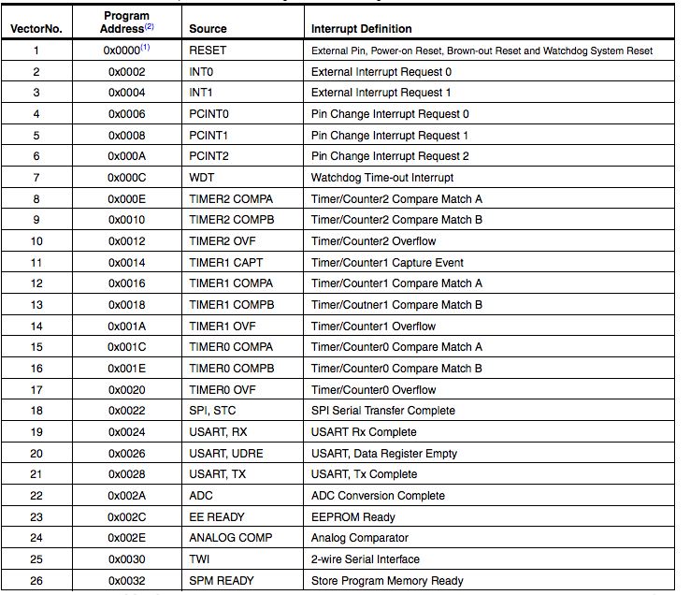
Atmega328p Interrupt Vector Table

Slide 12
Trigger
An asynchronous event which causes the interrupt
For example, the push button press during experiment 4 in our MES Lab can be a trigger.
It can cause an interrupt which is registered by the module and is reacted to.
However, what if all the conditions are not met but a trigger flag is set?
In this case, rather than the request being dismissed, it is held pending, postponed until a later time.

Slide 13
What happens after a trigger?
Once the interrupt is triggered and processed, the interrupt flag is cleared.
Clearing the interrupt flag is called acknowledgement.

Slide 14
Interrupt Service Routine (ISR)
The module that is executed when hardware requests an interrupt.
There may be 1 large ISR handling all the interrupt requests, or many small ISRs handling the many interrupts (interrupt vectors).
Example:
ISR (TIMER0_OVF_vect) //enabling overflow vector inside Timer0 using an ISR
ISR (TIMER0_COMPA_vect) //This is the Timer0 Compare ‘A’ interrupt service routine.
Remember, the ISR is a separate routine and requires a separate flowchart to represent.

Slide 15
General Rules for ISR
The ISR should execute as fast as possible.
  The interrupt should occur when it’s time to perform the required action
  The ISR should perform the action
  The ISR should end and return to the main function right away.
Placing backward branches (busy, wait, iterations) inside the ISR should be avoided.
The percentage of time spent executing ISR should be small when compared to the time between interrupt triggers.

Slide 16
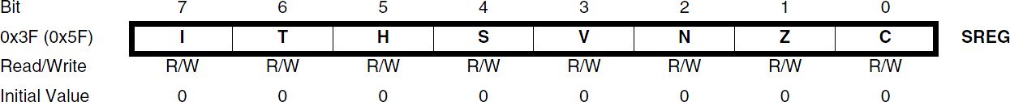
Atmega328p Interrupt Processing
When an interrupt occurs, the microcontroller completes the current instruction and stores the address of the next instruction on the stack.
It also turns off the interrupt system to prevent further interrupts while one is in progress. This is done by clearing the SREG Global Interrupt Enable I-bit.
The Interrupt flag bit is cleared for Type 1 Interrupts only (see the next Slide for Type definitions).

Slide 17
Atmega328p Interrupt Processing
The execution of the ISR is performed by loading the beginning address of the ISR specific for that interrupt into the program counter. The processor starts running the ISR.
Execution of the ISR continues until the return from interrupt instruction (reti) is encountered. The SREG I-bit is automatically set when the reti instruction is executed (i.e., Interrupts enabled).
When the processor exits from an interrupt, it will always return to the interrupted program and execute one more instruction before any pending interrupt is served.
The Status Register is not automatically stored when entering an interrupt routine, nor restored when returning from an interrupt routine. This must be handled by software.

Slide 18
Atmega328p Interrupt Processing – Type 1
The user software can write logic one to the I-bit to enable nested interrupts. All enabled interrupts can then interrupt the current interrupt routine.
  The SREG I-bit is automatically set to logic one when a Return from Interrupt instruction – RETI – is executed.
There are basically two types of interrupts…
    The first type (Type 1) is triggered by an event that sets the Interrupt Flag. For these interrupts, the Program Counter is vectored to the actual Interrupt Vector in order to execute the interrupt handling routine, and hardware clears the corresponding Interrupt Flag.

Slide 19
Atmega328p Interrupt Processing – Type 1
    If the same interrupt condition occurs while the corresponding interrupt enables bit is cleared, the Interrupt Flag will be set and remembered until the interrupt is enabled, or the flag is cleared by software (interrupt canceled).
    Interrupt Flag can be cleared by writing a logic one to the flag bit position(s) to be cleared.
      If one or more interrupt conditions occur while the Global Interrupt Enable (SREG I) bit is cleared, the corresponding Interrupt Flag(s) will be set and remembered until the Global Interrupt Enable bit is set on return (reti) and will then be executed by order of priority.

Slide 20
Atmega328p Interrupt Processing – Type 2
The second type (Type 2) of interrupts will trigger as long as the interrupt condition is present. These interrupts do not necessarily have Interrupt Flags. If the interrupt condition disappears before the interrupt is enabled, the interrupt will not be triggered.

Slide 21
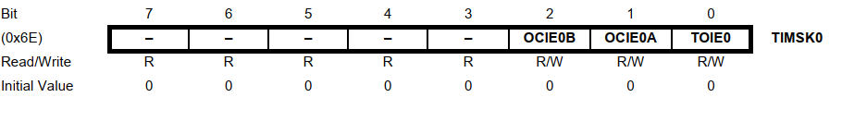
TIMSK0 – Timer/Counter0 Interrupt Mask Register
• Bits 7..3 – Res: Reserved Bits
These bits are reserved bits in the ATmega328P and will always read as zero.
• Bit 2 – OCIE0B: Timer/Counter Output Compare Match B Interrupt Enable
When the OCIE0B bit is written to one, and the I-bit in the Status Register is set, the Timer/Counter Compare Match B interrupt is enabled. The corresponding interrupt is executed if Compare Match in Timer/Counter0 occurs, i.e., when the OCF0B bit is set in the Timer/Counter Interrupt Flag Register – TIFR0.

Slide 22
TIMSK0 – Timer/Counter0 Interrupt Mask Register
• Bit 1 – OCIE0A: Timer/Counter0 Output Compare Match A: Interrupt Enable
When the OCIE0A bit is written to one, and the I-bit in the Status Register is set, the Timer/Counter0 Compare Match A interrupt is enabled. The corresponding interrupt is executed if a Compare Match in Timer/Counter0 occurs, i.e., when the OCF0A bit is set in the Timer/Counter 0 Interrupt Flag Register – TIFR0.
• Bit 0 – TOIE0: Timer/Counter0 Overflow Interrupt Enable
When the TOIE0 bit is written to one, and the I-bit in the Status Register is set, the Timer/Counter0 Overflow interrupt is enabled. The corresponding interrupt is executed if an overflow in Timer/Counter0 occurs, i.e., when the TOV0 bit is set in the Timer/Counter 0 Interrupt Flag Register – TIFR0

Slide 23
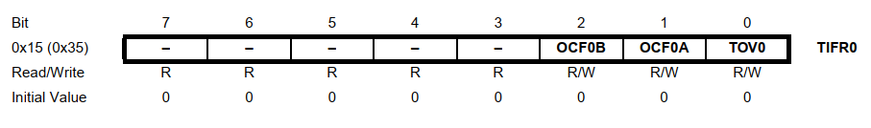
TIFR0 – Timer/Counter0 Interrupt Flag Register
• Bits 7..3 – Res: Reserved Bits
These bits are reserved bits in the ATmega328P and will always read as zero.
• Bit 2 – OCF0B: Timer/Counter 0 Output Compare B Match Flag
The OCF0B bit is set when a Compare Match occurs between the Timer/Counter and the data in OCR0B – Output Compare Register0 B. OCF0B is cleared by hardware when executing the corresponding interrupt handling vector. Alternatively, OCF0B is cleared by writing a logic one to the flag. When the I-bit in SREG, OCIE0B (Timer/Counter Compare B Match Interrupt Enable), and OCF0B are set, the Timer/Counter Compare Match Interrupt is executed.

Slide 24
TIFR0 – Timer/Counter0 Interrupt Flag Register
• Bit 1 – OCF0A: Timer/Counter 0 Output Compare A Match Flag
The OCF0A bit is set when a Compare Match occurs between the Timer/Counter0 and the data in OCR0A – Output Compare Register0. OCF0A is cleared by hardware when executing the corresponding interrupt handling vector. Alternatively, OCF0A is cleared by writing a logic one to the flag. When the I-bit in SREG, OCIE0A (Timer/Counter0 Compare Match Interrupt Enable), and OCF0A are set, the Timer/Counter0 Compare Match Interrupt is executed.

Slide 25
TIFR0 – Timer/Counter0 Interrupt Flag Register
• Bit 0 – TOV0: Timer/Counter0 Overflow Flag
The bit TOV0 is set when an overflow occurs in Timer/Counter0. TOV0 is cleared by hardware when executing the corresponding interrupt handling vector. Alternatively, TOV0 is cleared by writing a logic one to the flag. When the SREG I-bit, TOIE0 (Timer/Counter0 Overflow Interrupt Enable), and TOV0 are set, the Timer/Counter0 Overflow interrupt is executed.
The setting of this flag is dependent on the WGM02:0 bit setting

Slide 26
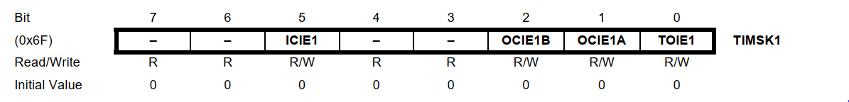
TIMSK1 – Timer/Counter1 Interrupt Mask Register
• Bit 7, 6 – Res: Reserved Bits
These bits are unused bits in the ATmega48P/88P/168P/328P, and will always read as zero.
• Bit 5 – ICIE1: Timer/Counter1, Input Capture Interrupt Enable
When this bit is written to one, and the I-flag in the Status Register is set (interrupts globally enabled), the Timer/Counter1 Input Capture interrupt is enabled. The corresponding Interrupt Vector is executed when the ICF1 Flag, located in TIFR1, is set.

Slide 27
TIMSK1 – Timer/Counter1 Interrupt Mask Register
• Bit 4, 3 – Res: Reserved Bits
These bits are unused bits in the ATmega328P and will always read as 0.
• Bit 2 – OCIE1B: Timer/Counter1, Output Compare B Match Interrupt Enable
When this bit is written to one, and the I-flag in the Status Register is set (interrupts globally enabled), the Timer/Counter1 Output Compare B Match interrupt is enabled. The corresponding Interrupt Vector is executed when the OCF1B Flag, located in TIFR1, is set.

Slide 28
TIMSK1 – Timer/Counter1 Interrupt Mask Register
• Bit 1 – OCIE1A: Timer/Counter1, Output Compare A Match Interrupt Enable
When this bit is written to one, and the I-flag in the Status Register is set (interrupts globally enabled), the Timer/Counter1 Output Compare A Match interrupt is enabled. The corresponding Interrupt Vector is executed when the OCF1A Flag, located in TIFR1, is set.
• Bit 0 – TOIE1: Timer/Counter1, Overflow Interrupt Enable
When this bit is written to one, and the I-flag in the Status Register is set (interrupts globally enabled), the Timer/Counter1 Overflow interrupt is enabled. The corresponding Interrupt Vector is executed when the TOV1 Flag, located in TIFR1, is set.

Slide 29
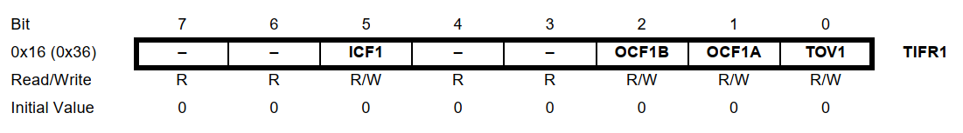
TIFR1 – Timer/Counter1 Interrupt Flag Register
• Bit 7, 6 – Res: Reserved Bits
These bits are unused bits in the ATmega328P and will always read as zero.
• Bit 5 – ICF1: Timer/Counter1, Input Capture Flag
This flag is set when a capture event occurs on the ICP1 pin. When the Input Capture Register (ICR1) is set by the WGM13:0 to be used as the TOP value, the ICF1 Flag is set when the counter reaches the TOP value. ICF1 is automatically cleared when the Input Capture Interrupt Vector is executed. Alternatively, ICF1 can be cleared by writing a logic one to its bit location.

Slide 30
TIFR1 – Timer/Counter1 Interrupt Flag Register
• Bit 4, 3 – Res: Reserved Bits
These bits are unused bits in the ATmega328P, and will always read as zero.
• Bit 2 – OCF1B: Timer/Counter1, Output Compare B Match Flag
This flag is set in the timer clock cycle after the counter (TCNT1) value matches the Output Compare Register B (OCR1B). Note that a Forced Output Compare (FOC1B) strobe will not set the OCF1B Flag. OCF1B is automatically cleared when the Output Compare Match B Interrupt Vector is executed. Alternatively, OCF1B can be cleared by writing a logic one to its bit location.

Slide 31
TIFR1 – Timer/Counter1 Interrupt Flag Register
• Bit 1 – OCF1A: Timer/Counter1, Output Compare A Match Flag
This flag is set in the timer clock cycle after the counter (TCNT1) value matches the Output Compare Register A (OCR1A). Note that a Forced Output Compare (FOC1A) strobe will not set the OCF1A Flag. OCF1A is automatically cleared when the Output Compare Match A Interrupt Vector is executed. Alternatively, OCF1A can be cleared by writing a logic one to its bit location.
• Bit 0 – TOV1: Timer/Counter1, Overflow Flag
The setting of this flag is dependent of the WGM13:0 bits setting. In Normal and CTC modes, the TOV1 Flag is set when the timer overflows.
Flag behavior when using another WGM13:0 bit setting. TOV1 is automatically cleared when the Timer/Counter1 Overflow Interrupt Vector is executed. Alternatively, TOV1 can be cleared by writing a logic one to its bit location.

Slide 32
500 ms Blink Example Code using Timer1 Interrupts
Timer 1 is used here. The values of TCCR1A and 1B are reset to 0 to make sure everything is clear. TCCR1B was set equal to 00000100 for a prescalar of 256. If you want to set ones, an OR operation can be used. If you want to set zeros, an AND operation can be used. The compare match mode for the OCR1A register is enabled. For that, the OCIE1A bit was set to be a 1 and that’s from the TIMSK1 register. So, we equal that to OR and this byte 00000010.
The OCR1A register was set to 31250 value so that we will have an interruption each 500ms. Each time the interrupt is triggered, we go to the related ISR vector. Since we have 3 timers, we have 6 ISR vectors, two for each timer and they have these names:
TIMER1_COMPA_vect,
TIMER1_COMPB_vect,
TIMER2_COMPA_vect,
TIMER2_COMPB_vect,
TIMER0_COMPA_vect,
TIMER0_COMPB_vect

Slide 33
500 ms Blink Example Code using Timer1 Interrupts
Timer 1 and compare register A was used so we need to use the ISR TIMER1_COMPA_vect. So below the void loop, the interruption routine is defined. Inside this interruption, the state of the LED was inverted, and a digital write was created. But first, the timer value was reset. Otherwise, it will continue to count up to its maximum value. So, each 500ms, this code will run and invert the LED state and that creates a blink of the LED connected to pin D5 for example.

Slide 34
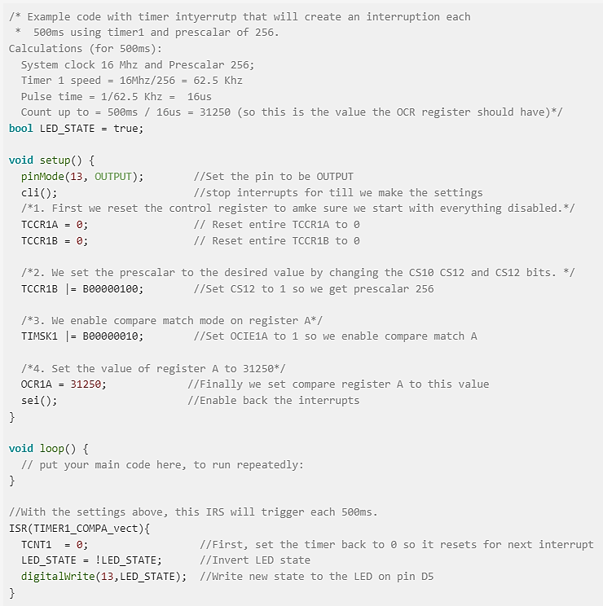
500 ms Blink Example Code using Timer1 Interrupts and Pre-scalar values of 256

Slide 35
500 ms Blink Example Code using Timer1 Interrupts

Slide 36
References
ATMega328 Datasheet
Arduino Uno Datasheet
Chapter 5: Microprocessors, Advanced Industrial Control Technology by Peng Zhang
http://www.ganssle.com/debouncing-pt2.htm
https://mansfield-devine.com/speculatrix/2018/04/debouncing-fun-with-schmitt-triggers-and-capacitors/
https://www.arxterra.com/10-atmega328p-interrupts/
http://www.gammon.com.au/forum/?id=11488

Slide 37

Thanks for attending….
?

